Slide 1
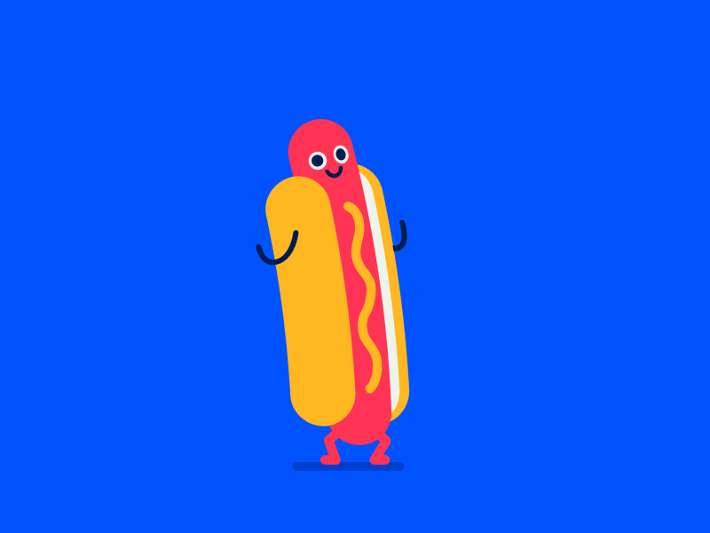
HOTDOG.py
Playfully created by Vallie E Tracy

Slide 2
OBJECTIVES Coming up with an idea
Get a better handle on functions, especially multiple functions working together
Practice working with a variety of concepts:
data types
data structures
for loops
while loops
Have Fun, Be Creative

Slide 3
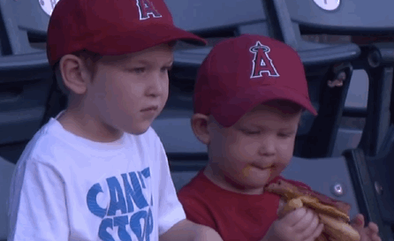
Minimum Viable Content:
1.) Introductory Conversation function
-strings
2.) Driving Directions function
-numbers
3.) Grocery Shopping function
-dictionary

Slide 4

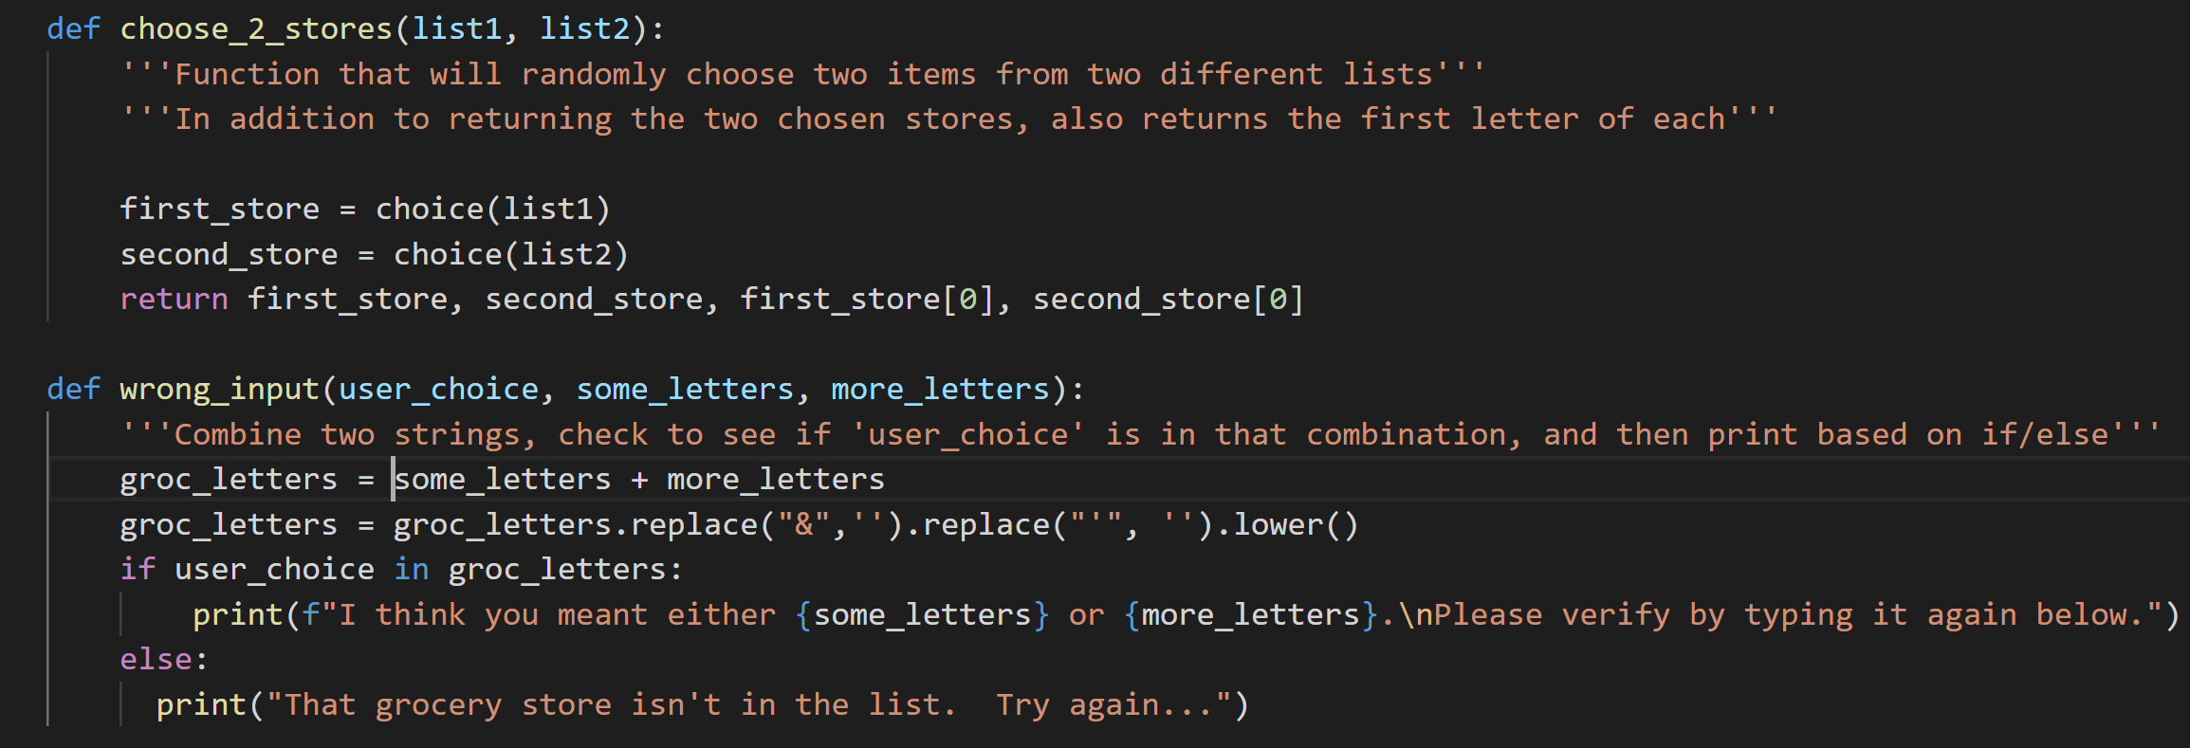
What it made me think about

Slide 5
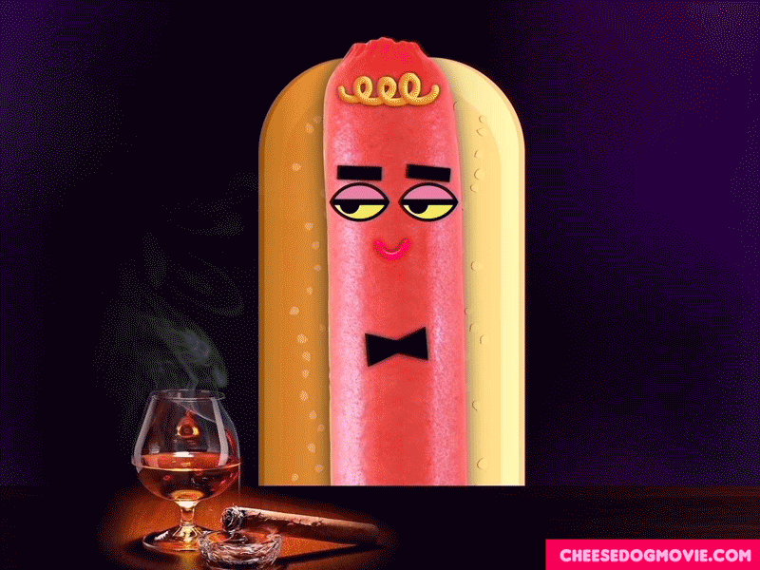
DEMO TIME!

